Slide 1


Slide 2
Introduction
Engaging Cloud Vendors
Management & Technical Operations
Notes:
Hello stakeholders, I am [Your Name]. Today, I am presenting our vendor evaluation for Besprotech Solutions Ltd. As we grow to a 10-employee team, our goal is to move from local silos to a unified cloud environment that supports our mission of tech facilitation and human capital development.

Slide 3
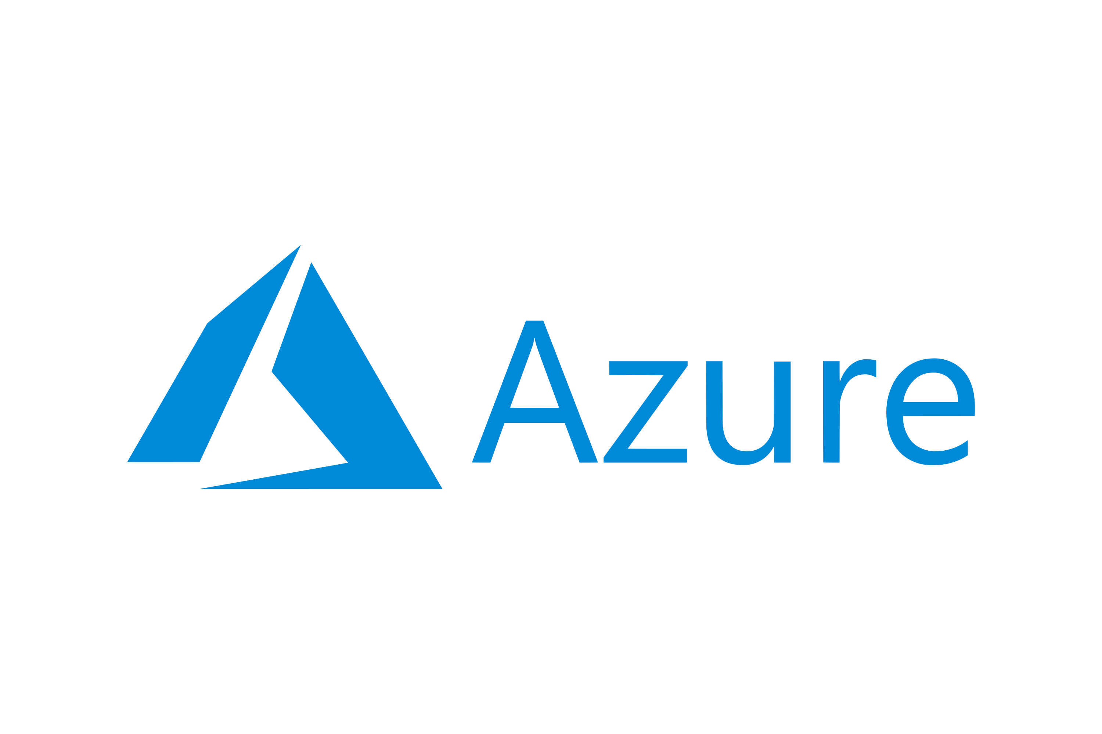

Vendor Comparison
vs
Notes:
We evaluated two giants: AWS and Microsoft Azure. AWS offers an incredible breadth of services, particularly in IoT. However, Azure stands out for us because it acts as a natural extension of the Microsoft tools we already use every day. It allows us to use our existing licenses to save money—a program called the Azure Hybrid Benefit

Slide 4
Evaluation & SLA
SN | Feature | Microsoft Azure | Amazon Web Services (AWS)
1 | Uptime (4 Nines) | 99.99% for VMs in Availability Zones. | 99.99% for Multi-AZ EC2 instances.
2 | Performance Level | High-speed global fiber backbone for low-latency traffic. | Broadest global infrastructure with 30+ geographic regions.
3 | Outage Recompense | Service credits (10%–25%) based on the severity of the monthly downtime. | Service credits applied toward future usage based on specific SLA breach tiers.
Notes:
We performed a Proof of Concept on both. While both platforms offer a 'four-nines' uptime (99.99%), Azure’s integration with our 10-person team’s identity management was significantly more streamlined. In the rare event of an outage, both providers offer service credits, ensuring our investment is protected.

Slide 5
Recommendation & Conclusion
Image Credits:
gadget.co.za
logo.wine
dootrix.com
Notes:
My final recommendation for Besprotech is Microsoft Azure. It offers the best 'Total Cost of Ownership' by leveraging our existing Microsoft ecosystem and provides the most user-friendly path for our employees to collaborate on client projects. Thank you for your time."

